Slide 2
THE TIPS PREVENTION PLATFORM
Live at Southeast Community College since July 2015.

Slide 3
At SCC we are committed to providing a safe and secure environment for all of our students, faculty and staff.
To help achieve this goal we have implemented a web-based incident reporting and incident management prevention platform called TIPS.
Notes:
Use this intro text or use your school mission.

Slide 4
The TIPS Prevention Platform
Empowering and equipping our entire campus community to CONFIDENTIALLY report concerning behaviors and potentially harmful situations and individuals WITHOUT FEAR.
Providing administrators the right TOOLS to take proactive prevention actions and generate POSITIVE RESULTS!

Slide 5
Why TIPS?
To keep our campus and stakeholder’s safe
To ensure you have a ‘voice’ and are heard
To empower you to share concerns
To maintain a positive campus climate
To help your peers get support if needed
To report information you might be reluctant to share in person
Notes:
May want to go into a little more detail for each bullet point before moving onto the next one.

Slide 6
Who can use TIPS?
EVERYONE!

Slide 7
Who can use TIPS?
Students
Notes:
Students can be the most important part of safety, threat assessment and prevention as they hear and see things throughout the day in class and in interacting with other students that faculty, staff and administration may not see or hear. As a student, reporting information you have can be a valuable piece of a puzzle in monitoring an at-risk individual.

Slide 8
Who can use TIPS?
Faculty
Notes:
Faculty have a unique perspective when it comes to students and interactions. If a students attendance or grades began to fall out of the ordinary, this could be a sing of something going wrong and faculty will be the first to know about and share such information with the right people.

Slide 9
Who can use TIPS?
Staff
Notes:
Staff also have a unique perspective as they may deal with most if not all students in a single day. Reporting concerning behaviors or suspicious activities that they notice and observe can provide even more feedback for the Threat assessment team to consider when making evaluations of an individual current state.

Slide 10
Who can use TIPS?
Parents
Notes:
PARENTS can be a students best advocate and partnering with your students college as early as possible can help resolve an issue quickly and effectively to ensure your student’s safety. The TIPS platform provides a simple and effective tool for parents to connect with their students college team, document all incidents and provide a clear audit trail of what the college knows and what actions were taken in response.

Slide 11
Who can use TIPS?
Community Members
Notes:
Community members play a crucial role in threat assessment and incident management as they interact with students and other community college stakeholders outside of the educational setting. The may notice certain warning signs that others may not see while and individual is in class or roaming the halls.

Slide 12
What to report…
Any kind of non-emergency information

Slide 13
What can be reported?
Academic Plagiarism and Dishonesty
Assaults
Cyber Threat/Abuse
Harassment
Notes:
For each of the incident types your college plans to include in TIPS, you should talk to your students about what situations each incident type is referring to.

Slide 14
What can be reported?
Suicidal Thoughts and Self Abuse
Stalking
Sex Offenses
Safety and Security Issues
Notes:
For each of the incident types your college plans to include in TIPS, you should talk to your students about what situations each incident type is referring to.

Slide 15
What can be reported?
Tobacco Violations
Accident or Injury
Weapons
Drugs or Alcohol Violations
Notes:
For each of the incident types your college plans to include in TIPS, you should talk to your students about what situations each incident type is referring to.

Slide 16
What can be reported?
Burglary/
Theft
Medical Incident Report
Vandalism
Trespassing
Notes:
For each of the incident types your college plans to include in TIPS, you should talk to your students about what situations each incident type is referring to.

Slide 17
What can be reported?
Disturbances
Vehicle Incident/ Accident/ Injury
Fire
(not in progress)
Workplace Issues or Concerns
Notes:
For each of the incident types your college plans to include in TIPS, you should talk to your students about what situations each incident type is referring to.

Slide 18
What can be reported?
Concerning Behaviors
Domestic, Dating and Relationship Violence
Suspected Abuse or
Neglect
Inappropriate Student/ Faculty Relationships
Notes:
For each of the incident types your college plans to include in TIPS, you should talk to your students about what situations each incident type is referring to.

Slide 19
INDICATORS that we need to know about
Unusual or abrupt changes in behaviors, mood, personal hygiene or appearance
Extreme reaction to a loss or traumatic event;
Preoccupation with weapons, violent events, or persons who have engaged in violent acts;
Uncharacteristically poor performance at school or job;
Notes:
Share these with students to help make them aware what the warning signs, or red flags, are for an individual who may be at-risk or may need help. It also good to point out that showing just one of these signs may not be a cause for concern, but that is why reporting them to a central secure platform like TIPS helps staff and administration connect other reports that may come in for the same individual, so they can determine if a threat is apparent.

Slide 20
INDICATORS that we need to know about
References to harming others or planning a violent or destructive event;
Evidence of depression, hopelessness, or suicidal thoughts/plans;
Inappropriate responses such as prolonged irritability, angry outbursts, or intense reactions;
General statements of distorted, bizarre thoughts
Notes:
Share these with students to help make them aware what the warning signs, or red flags, are for an individual who may be at-risk or may need help. It also good to point out that showing just one of these signs may not be a cause for concern, but that is why reporting them to a central secure platform like TIPS helps staff and administration connect other reports that may come in for the same individual, so they can determine if a threat is apparent.

Slide 21
INDICATORS that we need to know about
Strained interpersonal relations, isolating behaviors, or low self-esteem;
Significant change in life circumstances such as death of family member or pet, divorce, break-up etc.
Excessive feelings of isolation, rejection and/or persecution
Unusual or threatening social media posts
Notes:
Share these with students to help make them aware what the warning signs, or red flags, are for an individual who may be at-risk or may need help. It also good to point out that showing just one of these signs may not be a cause for concern, but that is why reporting them to a central secure platform like TIPS helps staff and administration connect other reports that may come in for the same individual, so they can determine if a threat is apparent.

Slide 22
Still unsure what to report?
A good rule to follow is:
“If a situation makes you or someone else uncomfortable, you should click on the TIPS button and report it.”
Notes:
Good point to ask if there are any questions on what should be reported, and discuss why its important to report any concerns.
Also a good point to define “Indicators” further as concerning behaviors, suspicious activities, social media comments, social media pictures, social media threats and other actions that make you uncomfortable.

Slide 23
Your report can make a difference!
Indicators leading up to Tucson, AZ shooting on January 8, 2011.
Notes:
This slide shows the escalation of the Tucson, AZ shooter in college and in his community prior to the shooting that killed and injured 15 others.

Slide 24
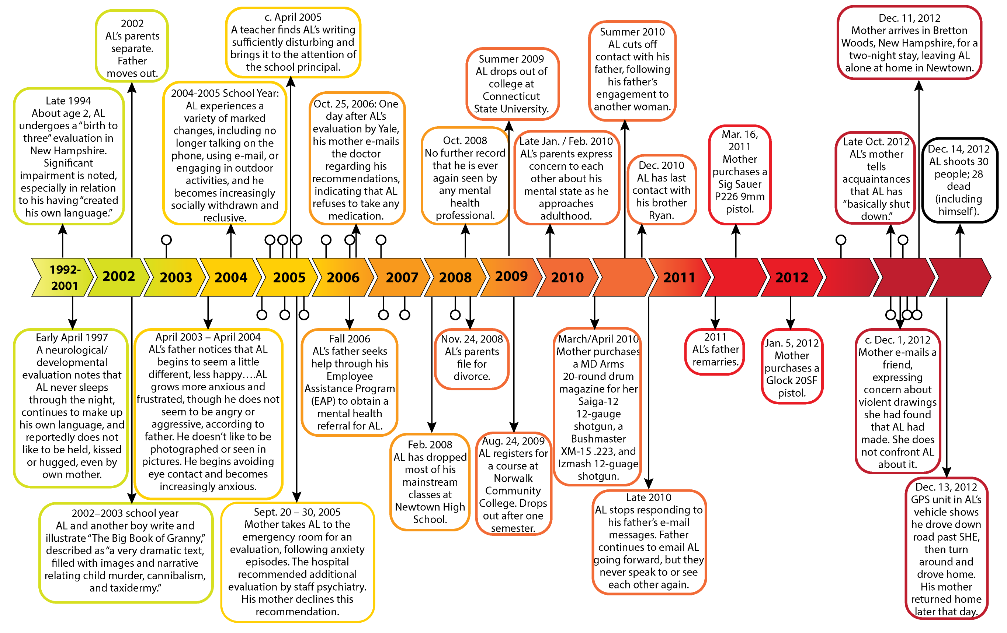
Your report can make a difference!
Indicators leading up to Sandy Hook Elementary massacre on December 14, 2012.
Notes:
This slide shows the escalation of the Sandy Hook Elementary shooter with warning signs noticed at his school and in his community prior to the shooting that killed 27 (20 of which were 6 and 7 year olds) and injured 2 others.

Slide 25
Where to go...

Slide 26
Look for the TIPS button on the Southeast Community College website
www.southeast.edu

Slide 27
Click on ‘TIPS’ to access the TIPS reporting site

Slide 28
Filling out a report...

Slide 29
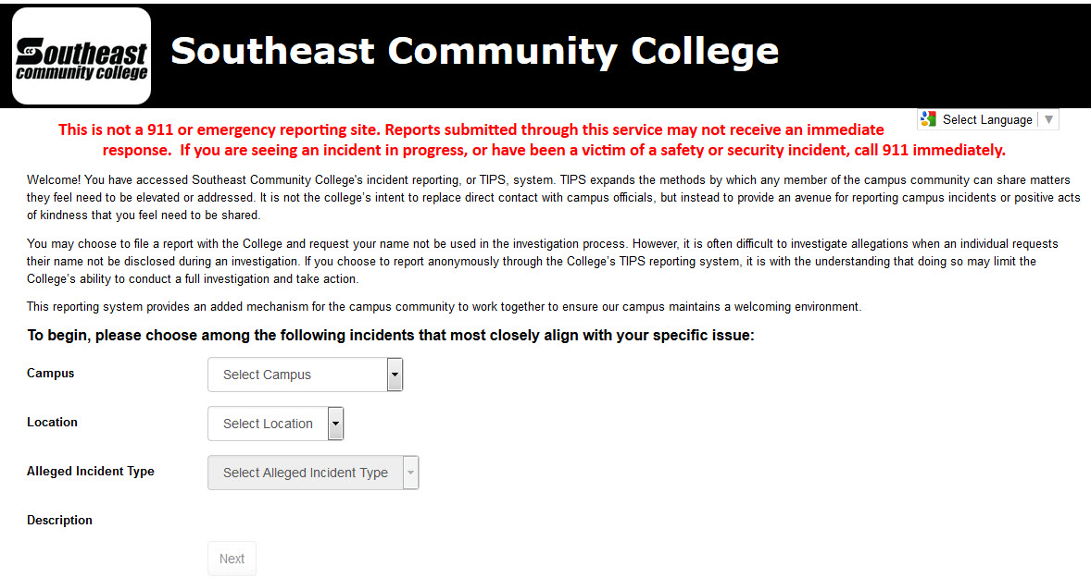
To begin, choose the campus and location of the report, then select the alleged incident type.

Slide 30
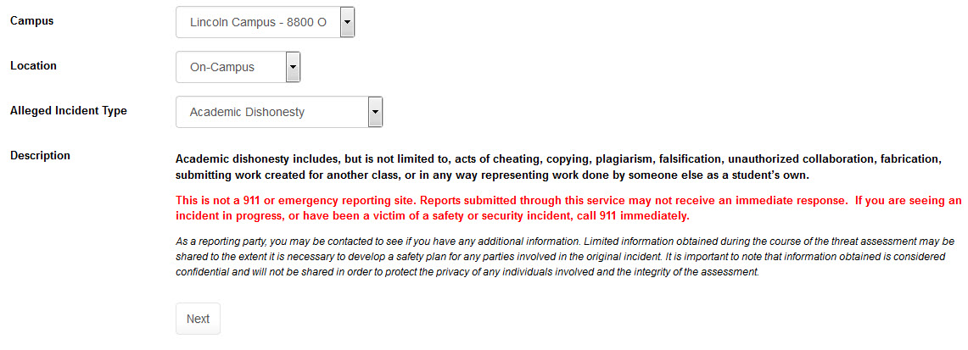
You can review the description provided for each incident type to determine if this aligns with your specific issue.
Click Next.

Slide 31
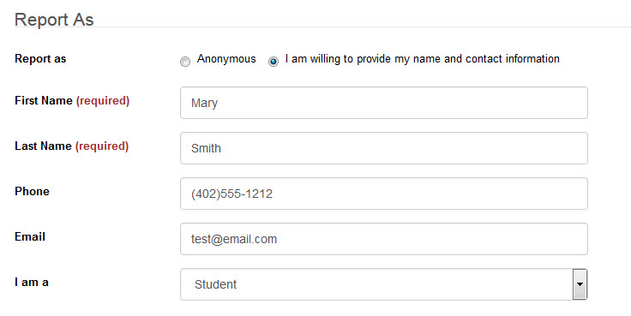
You may choose to file a report with the College and request your name not be used in the investigation process. However, it is often difficult to investigate allegations when an individual requests their name not be disclosed during an investigation. Please keep this in mind as you fill out your report.

Slide 32
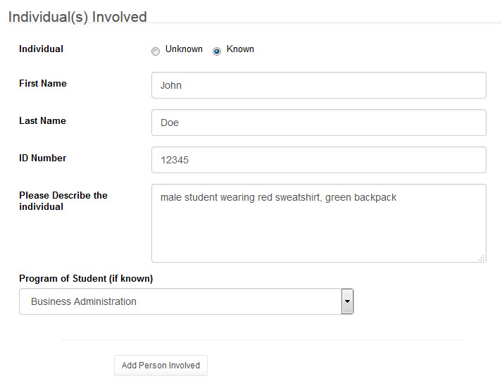
Describe the individual(s) involved with as many details as possible. If you do not know the ID number, leave this information blank.
If multiple individuals are involved, click the Add Person Involved button to add others to the report.

Slide 33
Select the location of incident and provide the date and time the incident occurred. You may enter in a date range if needed.

Slide 34
If you are able to provide a screenshot of social media comments, a picture from your phone, or other electronic documents that will assist in the investigation of your report, please upload.
This information can be extremely helpful to the investigation team.

Slide 35
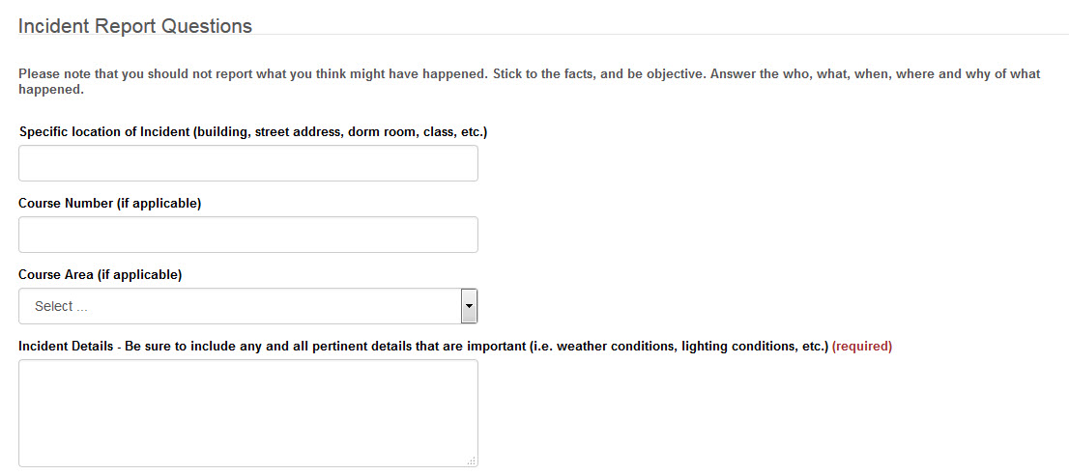
Answer the Incident Report Questions as thoroughly as possible. Please note that you should not report what you think might have happened. Stick to the facts , and be objective. Answer the who, what, when, where and why of what happened.

Slide 36
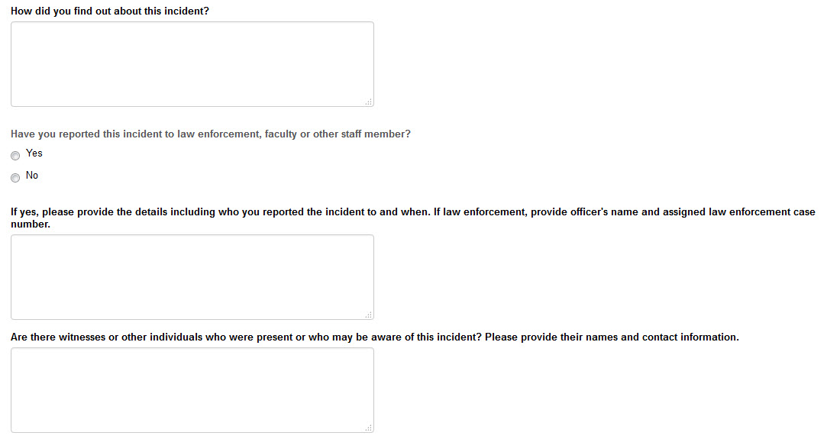
Answer the Incident Report Questions as thoroughly as possible. Please note that you should not report what you think might have happened. Stick to the facts , and be objective. Answer the who, what, when, where and why of what happened.

Slide 37
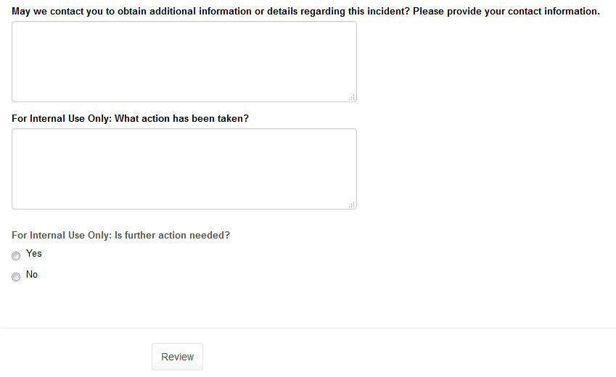
If you are reporting anonymously, but wish to provide an e-mail address or other information that can be used to contact you for follow-up, please provide contact information at the end. If you are a staff member, you can also use this area to describe what action(s) have been taken to date and if further action is needed.
Once your report is complete, click Review.
Your report has not been submitted at this time. Continue to next step.

Slide 38
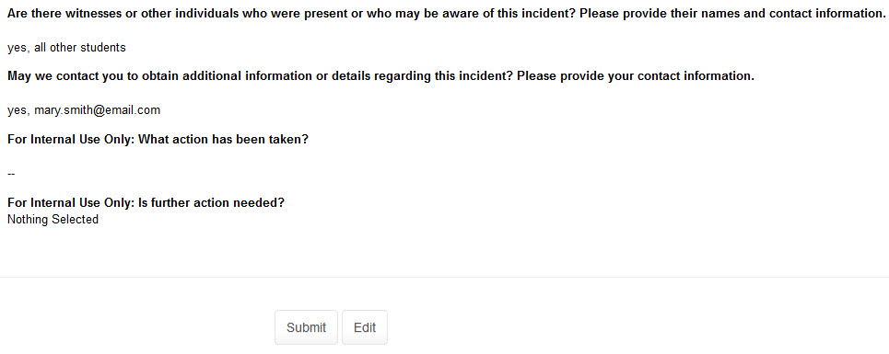
You will then be able to review your report for accuracy. If you need to make any changes, please click Edit. If you are satisfied with your report, click Submit.
You will receive confirmation that your report has been submitted and a Report Number. You may want to write down this report number for your records or follow-up.

Slide 39
Frequently Asked Questions
Anonymous?
Submit, then what?
Follow-up?
Required?

Slide 40
Is my report really Anonymous?
YES! Utilizing the TIPS incident reporting button allows you to choose the truly anonymous option, so you have nothing to fear in sharing your observations and concerns.
If you choose to be anonymous, your institution will not be able to follow-up with you, so if you want a follow-up response you can choose the confidential option and provide your name and/or a way to contact you by either phone or e-mail.
Anonymous?
Submit, then what?
Follow-up?
Required?

Slide 41
Once I submit a report into TIPS, what happens?
All reports are securely transmitted to and stored within your institution’s TIPS platform. Immediate notifications are sent to the appropriate personnel at your institution. Reports will only be viewed and accessible by approved personnel and all information will remain confidential. Once the team has reviewed your report/ concerns, appropriate investigation and follow-up efforts will occur.
Anonymous?
Submit, then what?
Follow-up?
Required?

Slide 42
How do I know if someone has taken action on my report?
If you would like feedback regarding the report you submit or if you would like to be available for follow up questions, you can provide your name and contact information. All information provided will be kept strictly confidential.
Anonymous?
Submit, then what?
Follow-up?
Required?

Slide 43
Do I have to use TIPS to make a report?
No. TIPS should not replace face-to-face communication with faculty, staff and administrators when you have concerns or questions. TIPS is for equipping students, faculty, staff, parents and community members to share information/observations when they may be uncomfortable sharing it in person.
Anonymous?
Submit, then what?
Follow-up?
Required?

Slide 44
Still have questions?
Contact:
^{Sam Loos}
^{Safety & Security Specialist}
^{xxx-xxx-xxxx}
^{xxxxxxxx@southeast.edu}
^{Mark Meints} ^{Safety & Security Specialist}
^{xxx-xxx-xxxx}
^{xxxxxxxx@southeast.edu}
^{Brian Torrence}
^{Safety & Security Coordinator}
^{xxx-xxx-xxxx}
^{xxxxxxxx@southeast.edu}
Or stop by the student service's office.

